Slide 1



Cipher
Multi-Resume
Premium Analyzer

Slide 2

Resume evaluation is manual, inconsistent, and time-consuming
Recruiters must handle thousands of applications weekly across multiple locations
Shortlisting delays lead to slower hiring cycles and missed opportunities
Lack of actionable feedback leaves students unsure of how to improve their resumes
PROBLEM
STATEMENT

Slide 3

Cipher: An automated, AI-powered Resume Relevance Analyzer
Upload one Job Description & multiple resumes → instant analysis
Generates scores, gaps, and personalized AI feedback
Helps recruiters shortlist faster and students improve smarter
OUR
SOLUTION

Slide 4






KEY FEATURES
🤖 AI-driven Resume Suggestions with downloadable PDF reports
📊 Relevance Scoring (0–100) with verdict: High / Medium / Low
🏆 Best Candidate Highlighting across all applicants
🔍 Skill Coverage Analysis & ATS compatibility checks

Slide 5







TECHNOLOGY
SentenceTransformers / HuggingFace — semantic text embeddings
Plotly & Pandas — dynamic charts and analytics
ReportLab — export AI feedback as professional PDF reports
Python & Streamlit — interactive web UI
FAISS / ChromaDB (optional) — efficient semantic search

Slide 6
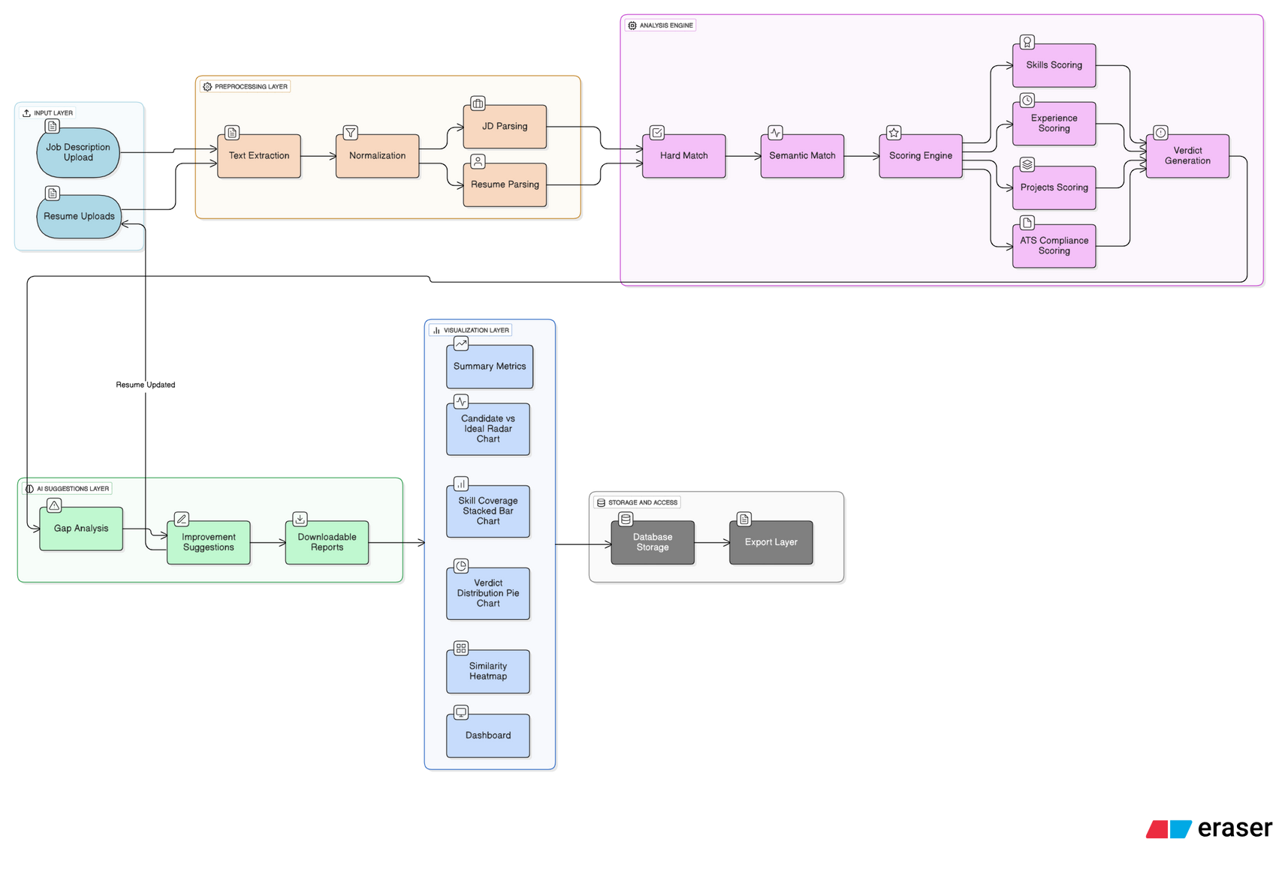
SYSTEM FLOW

Slide 7

⏱️ Cuts resume screening time from hours to minutes
⚖️ Ensures consistent, unbiased evaluation across candidates
🚀 Improves placement outcomes & recruiter satisfaction
🎓 Empowers students with clear, personalized improvement feedback
IMPACT

Slide 8

THANK
YOU.
- TheTeam

